Slide 1
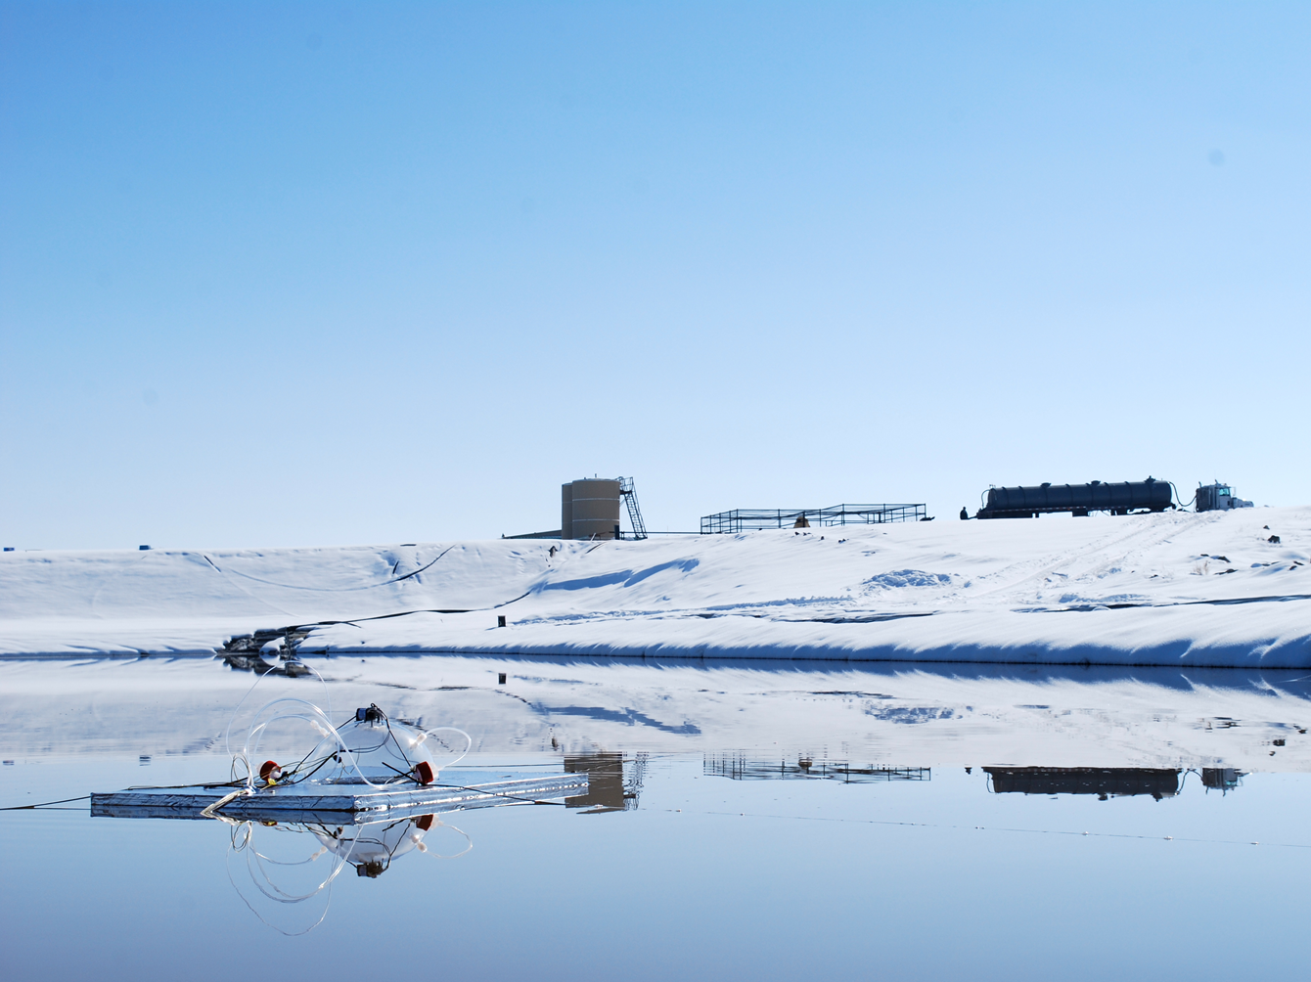

Produced Water Emissions Research Summary
Marc Mansfield, Huy Tran, and Seth Lyman

Slide 2
Measurement Techniques:
Flux Chamber
~225 hour-long measurements in Uinta Basin and Wyoming at 10 facilities (facilities in Basin account for 25% of total Basin pond area)
Evidence exists that chamber is biased low in high winds. More about this later
Cavity ring-down CH₄/CO₂/H₂O analyzer
Acrylic floating flux chamber
Control/measurement of flow, pressure, temp
Fused silica-lined canisters
for C2-C11 hydrocarbons
(Conc_{in} – Conc_{out})
Surface area
Flux = × Flow Rate
Notes:
2

Slide 3
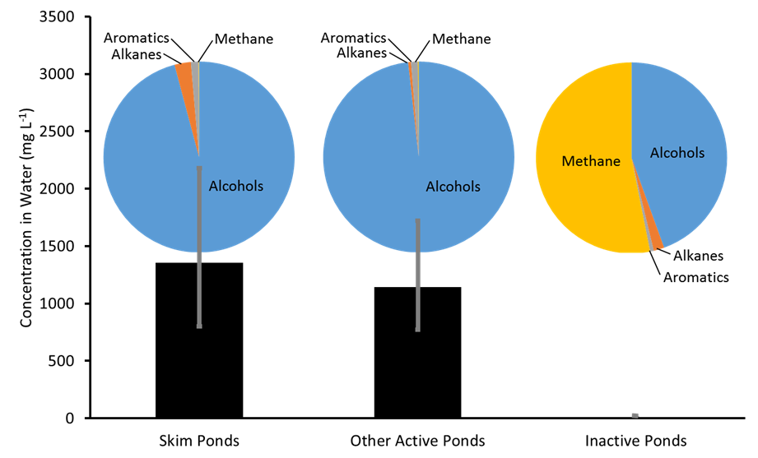
Water Composition
Notes:
3

Slide 4
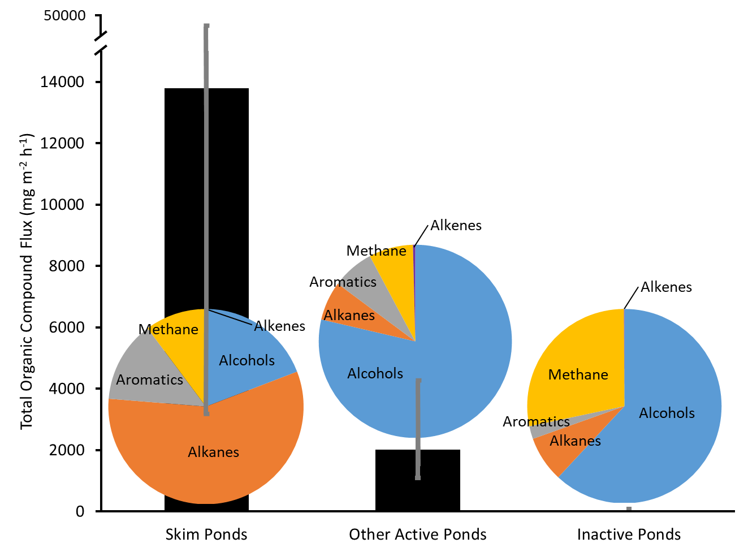
Emission Flux Composition
Notes:
4

Slide 5
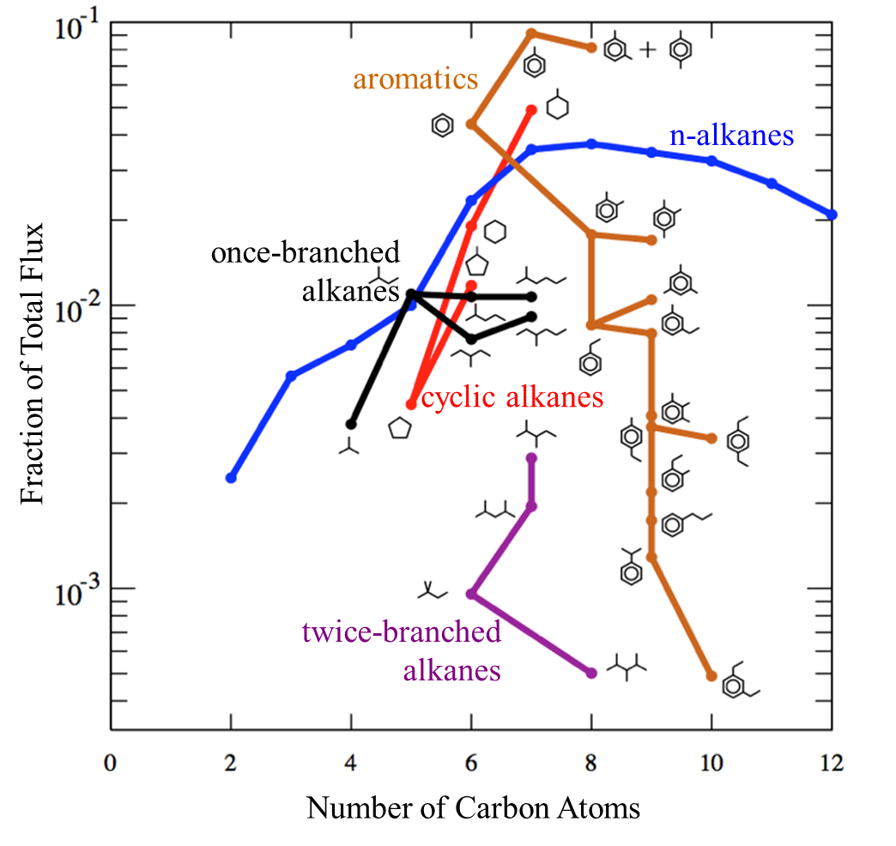
Emission Flux Composition
Notes:
5

Slide 6
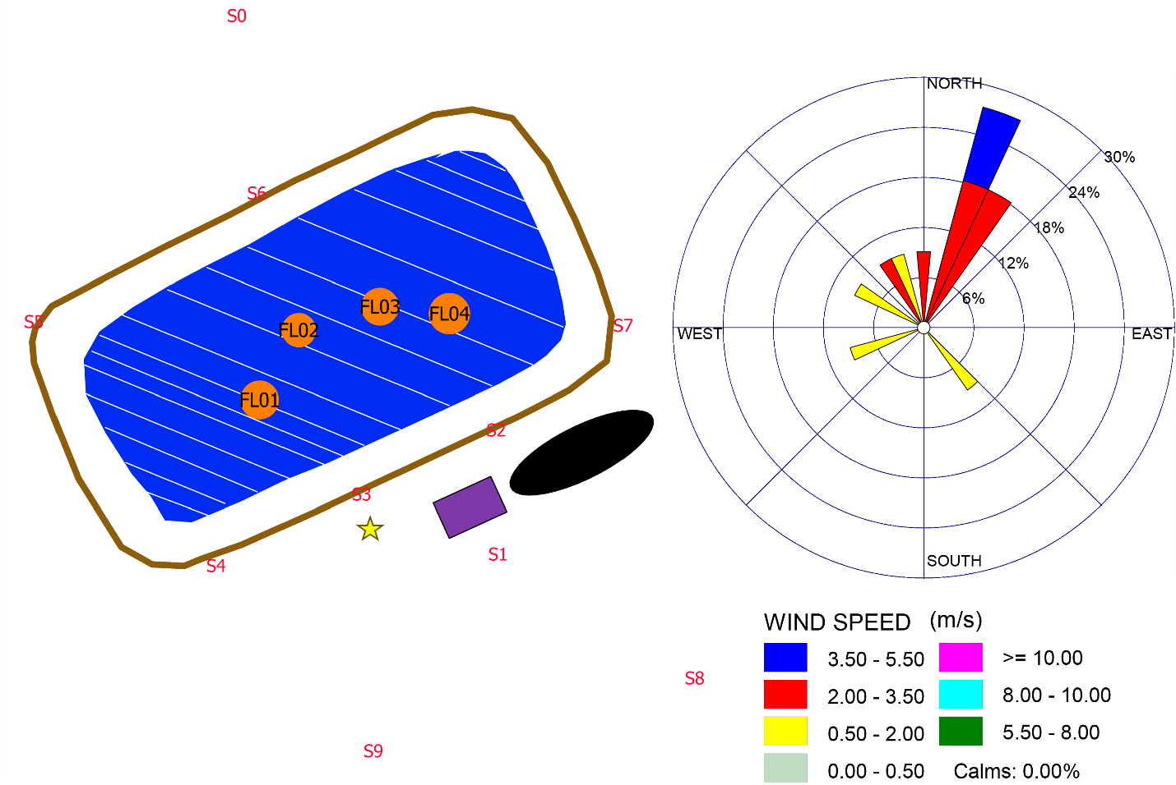
Inversed-modeling: Case study
Inverse dispersion models:
Utilized models: EPA regulatory AERMOD and the Heavy Gas dispersion model for Steady-state (HEGADAS-S).
Notes:
6

Slide 7
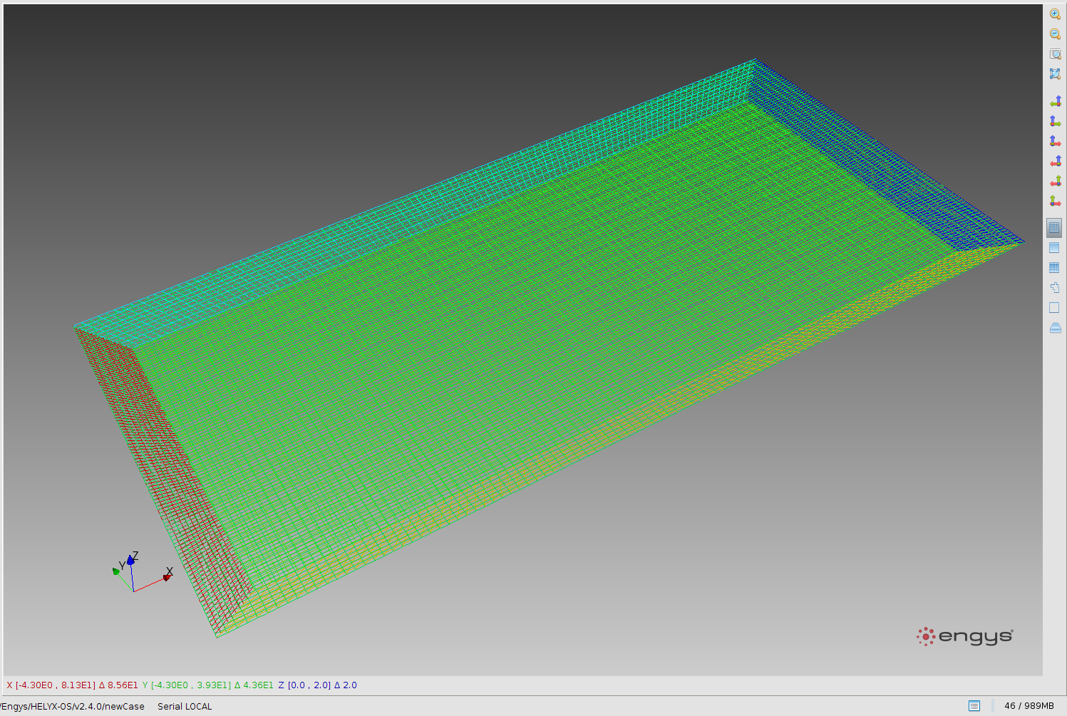
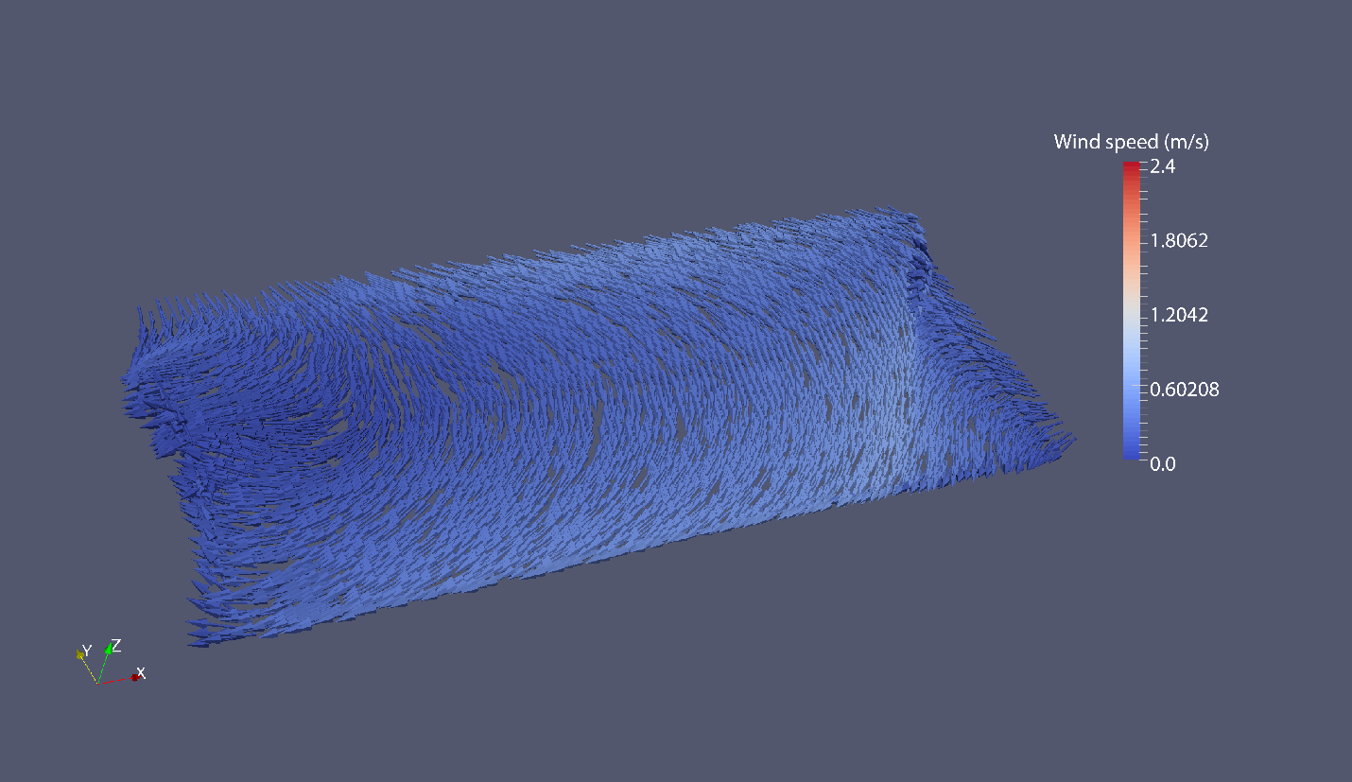
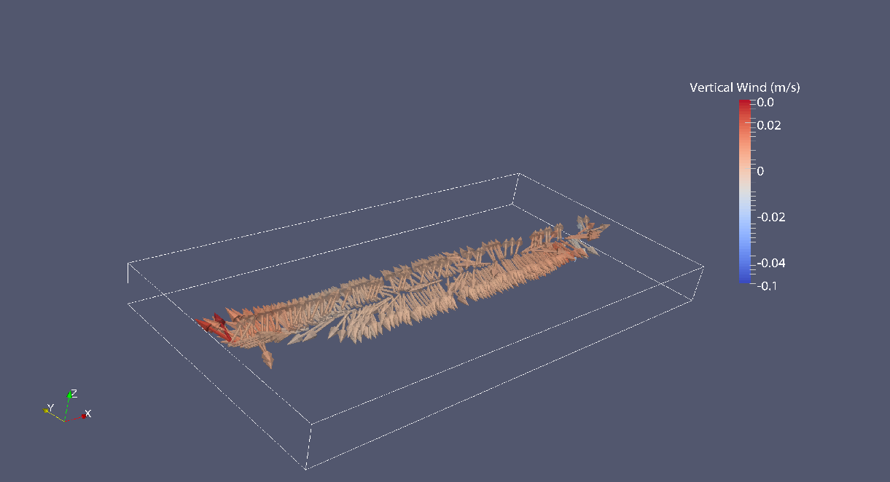
Inversed-modeling: Wind complexities
Fluid dynamic model suggests:
wind speeds at water level significantly differ from wind speed at 6 m above ground level
emission rate is not uniform at every point over pond’s surface. Emissions are mainly released from up-wind part of the pond.
Notes:
7

Slide 8
Inversed-modeling: Results vary with techniques used
Comparisons of NMHC concentration distributions (excluding alcohols)
Canister measurements
HEGADAS-S full-pond
HEGADAS-S partial-pond
AERMOD open-pit
Notes:
8

Slide 9
Inversed-modeling consistently overestimate flux-chamber measurements
Measurement Campaign | Means of estimation | Alkanes | Alkenes | Aromatics | Alcohols | Total NMHC
April 2015 (Landfarm) | FLUX | 287.5 | 4.6 | 83.8 | 2.4 | 378.3
 | FLUX-C | The developed wind correction factors are not applicable for air-soil exchange interface
 | AERM | 2891.0 | 0.4 | 1068.8 | 29.6 | 3990
 | HEGA | 2690.4 | 0.8 | 1027.1 | 11.1 | 3729
Apr2016 (Pond) | FLUX | 34.0 | 0.0 | 60.4 | 201.5 | 296
 | FLUX-C | 37.9 | 0.0 | 67.1 | 659.6 | 765
 | AERM-1 | 714.8 | 1.3 | 628.1 | 312.8 | 1657
 | HEGA-1 | Was not performed due to calm and strongly variate wind
 | AERM-2 | 525.1 | 16.0 | 490.6 | 2658.2 | 3690
 | HEGA-2 | 149.6 | 6.2 | 142.9 | 866.3 | 1165
 | AERM-3 | 659.7 | 26.8 | 748.6 | 1729.3 | 3164
 | HEGA-3 | 495.1 | 15.1 | 388.4 | 1148.4 | 2047
Jul2016 (Pond) | FLUX | 24.4 | 0.0 | 67.6 | 108.8 | 201
 | FLUX-C | 46.0 | 0.1 | 123.3 | 545.6 | 715
 | AERM-1 | 261.7 | 4.2 | 265.8 | 1327.0 | 1859
 | HEGA-1 | 114.9 | 1.5 | 143.3 | 686.3 | 946
 | AERM-2 | 417.4 | 3.9 | 1063.7 | 1935.8 | 3421
 | HEGA-2 | 160.8 | 0.8 | 424.0 | 728.8 | 1314
Geometric means of ratios | HEGA/FLUX-C | 5.3 | 2.7 | 3.6 | 1.8 | 2.5
 | AERM/FLUX-C | 11.5 | 5.2 | 7.5 | 2.8 | 4.2
 | HEGA/AERM | 0.5 | 0.5 | 0.5 | 0.4 | 0.5
Notes:
9

Slide 10
Mass-Transfer Law
F = S c
Flux
(g/m²/h)
Mass-transfer coefficient
(m/h)
Pond concentration
(g/m³)
Proportionality between flux and concentration.
S may depend on:
temperature, wind speed, salinity,
nature of compound
Notes:
10

Slide 11
WATER-9
Semi-empirical algorithm for estimating S (H = Henry’s law coefficient, it
anti-correlates with solubility.)
Blue, tan, black:
Temperature modulation.
Salinity modulation is
about 30% to 50% in H.
Notes:
11

Slide 12
WATER-9 prediction of flux chamber results.
Accurate to within about 1 order of
magnitude over a range of about
5 orders.
Notes:
12

Slide 13
Wind Speed Correction
Based on WATER-9
Notes:
13

Slide 14
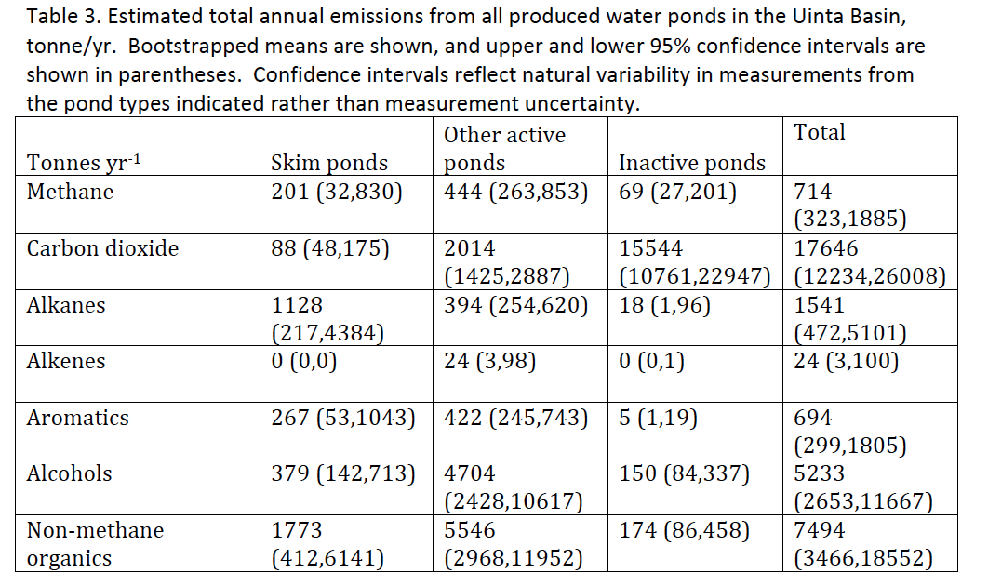
Basin-wide scale up
Notes:
14

Slide 15
Acknowledgements
Funding Provided By
  U.S. Department of Energy/Research Partnership to Secure Energy for America (Contract No. 12122-15)
  Bureau of Land Management (Cooperative Agreement No. L13AC00292)
  Uintah Impact Mitigation Special Service District
  GSI, Inc./State of Wyoming
  Utah State and Institutional Trust Lands Administration
Notes:
15

Slide 16
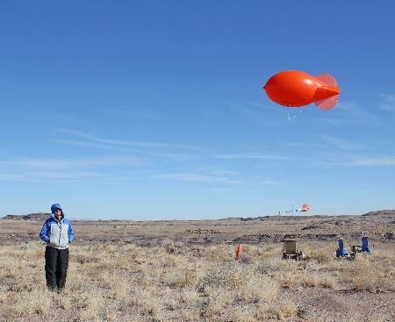
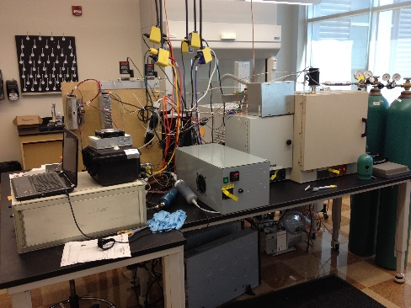
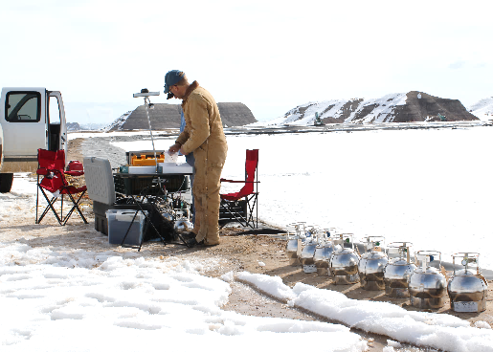
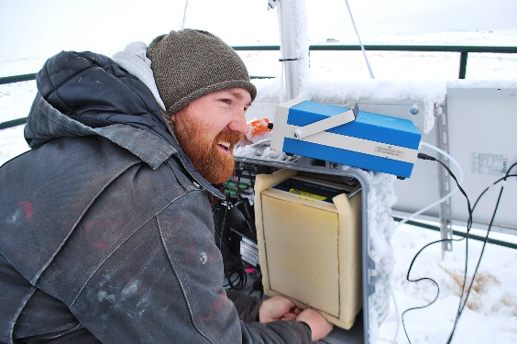
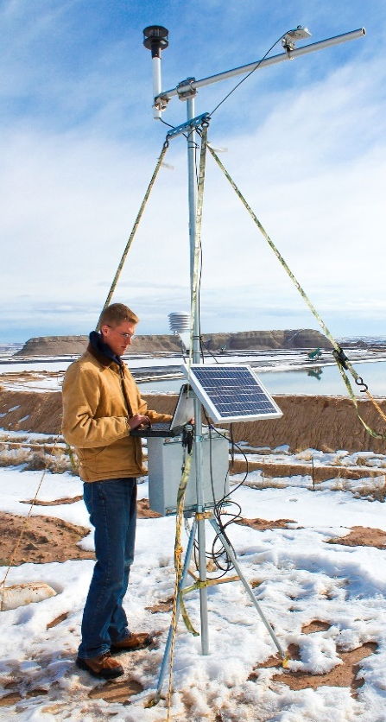
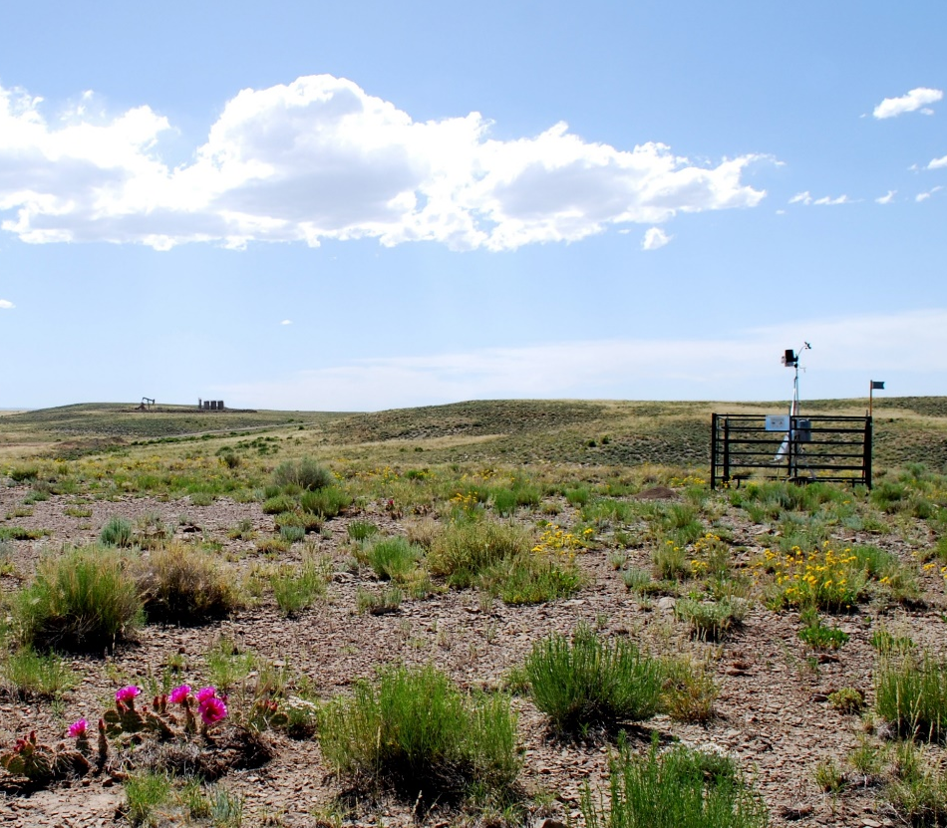
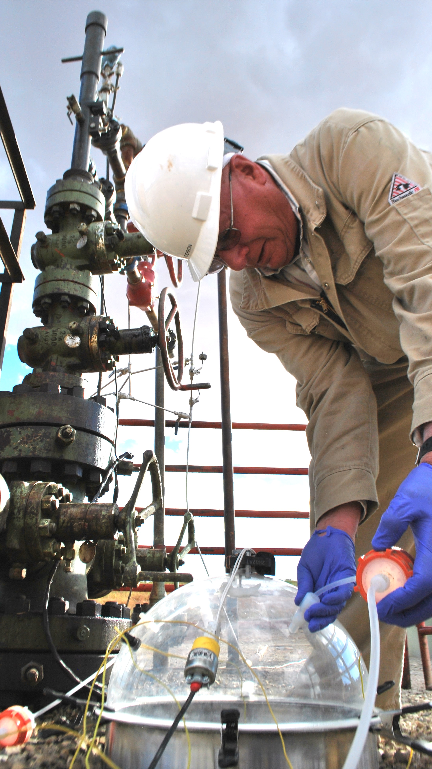
Thank You
binghamresearch.usu.edu

